Slide 1
Chapter 15 Benzene and Aromaticity

Slide 2
Learning Objectives
(15.1)
Naming aromatic compounds
(15.2)
Structure and stability of benzene
(15.3)
Aromaticity and the Hückel 4n + 2 rule
(15.4)
Aromatic ions

Slide 3
Learning Objectives
(15.5)
Aromatic heterocycles: Pyridine and pyrrole
(15.6)
Polycyclic aromatic compounds
(15.7)
Spectroscopy of aromatic compounds

Slide 4
Naming Aromatic Compounds
Coal and petroleum are the major sources of simple aromatic compounds
Coal primarily comprises of large arrays of conjoined benzene-like rings
When heated to 1000°C, coal thermally breaks down to yield coal tar
Petroleum primarily comprises alkenes and few aromatic compounds
Notes:
Naming aromatic compounds

Slide 5
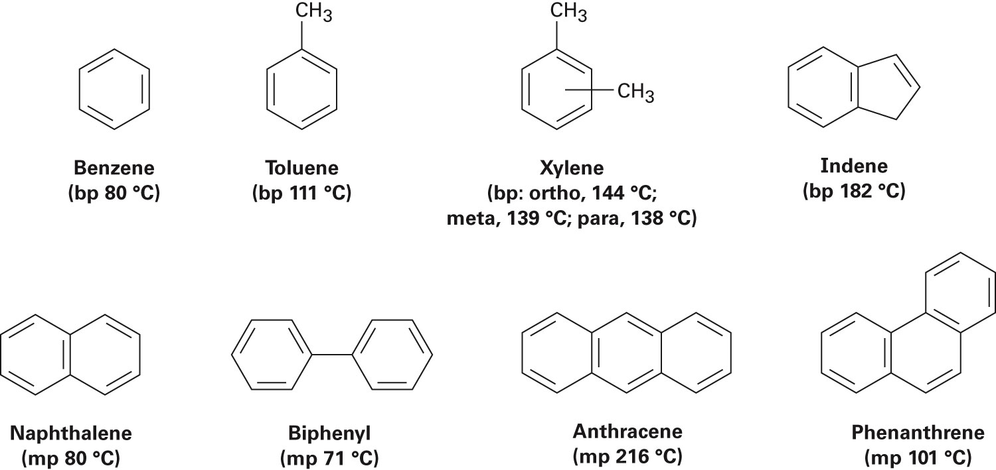
Figure 15.1 - Some Aromatic Hydrocarbons
Notes:
Naming aromatic compounds

Slide 6
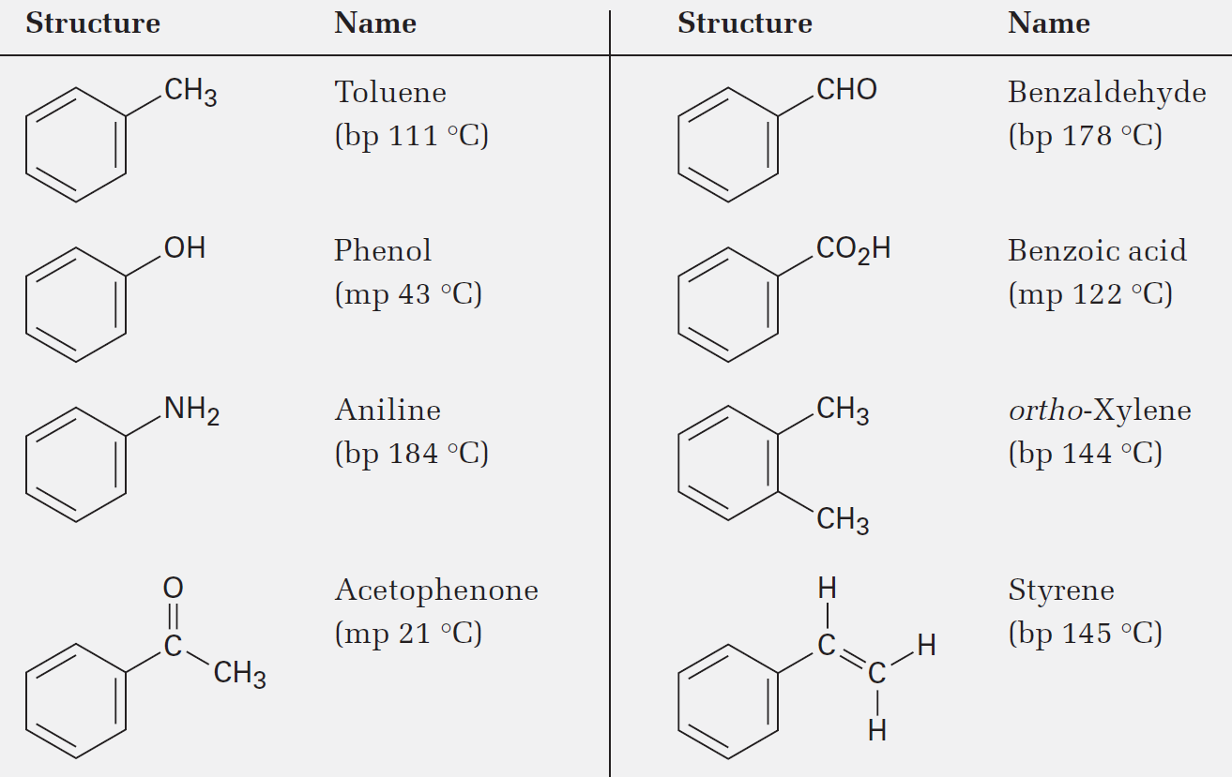
Naming Aromatic Compounds
Aromatic compounds possess the largest number of nonsystematic names, of which some are allowed by the IUPAC
Notes:
Naming aromatic compounds

Slide 7
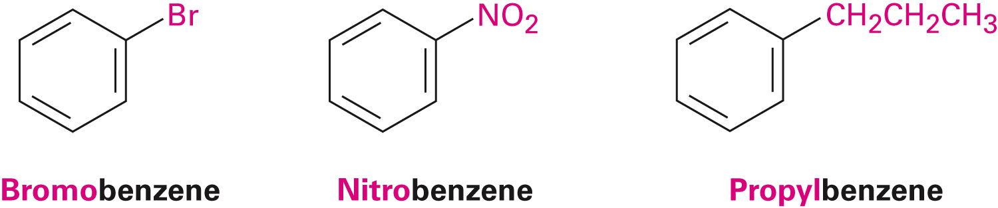
Naming Aromatic Compounds
Monosubstituted benzenes have systematic names with –benzene being the parent name
Notes:
Naming aromatic compounds

Slide 8
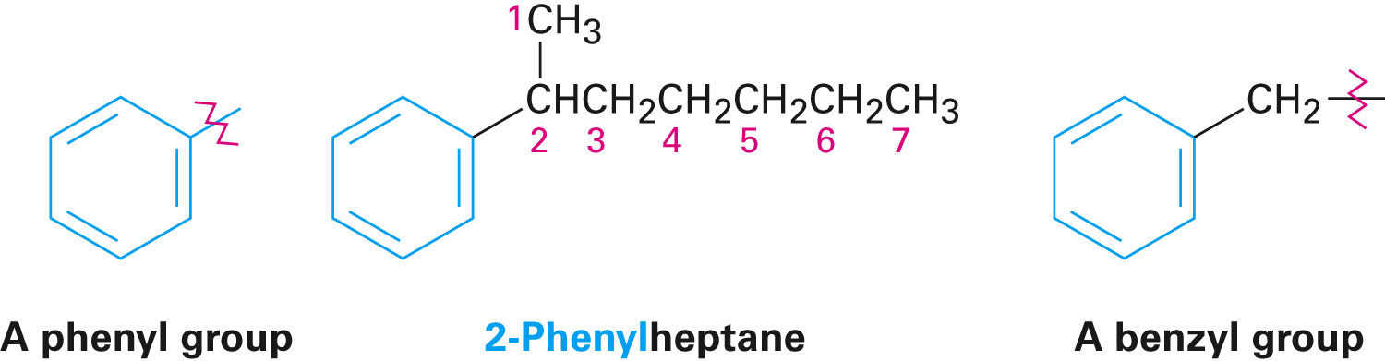
The Phenyl Group
Arenes are alkyl-substituted benzenes
Based on the size of the alkyl substituents, they are termed alkyl-substituted or phenyl-substituted benzene
The term phenyl (Ph or Φ) is used in cases of a substituent benzene ring in the –C₆H₅
The term benzyl is used for the C₆H₅CH₂– group
Notes:
Naming aromatic compounds

Slide 9
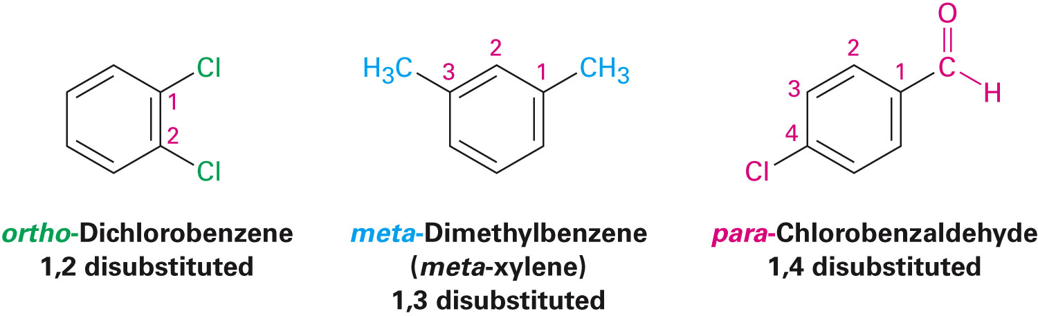
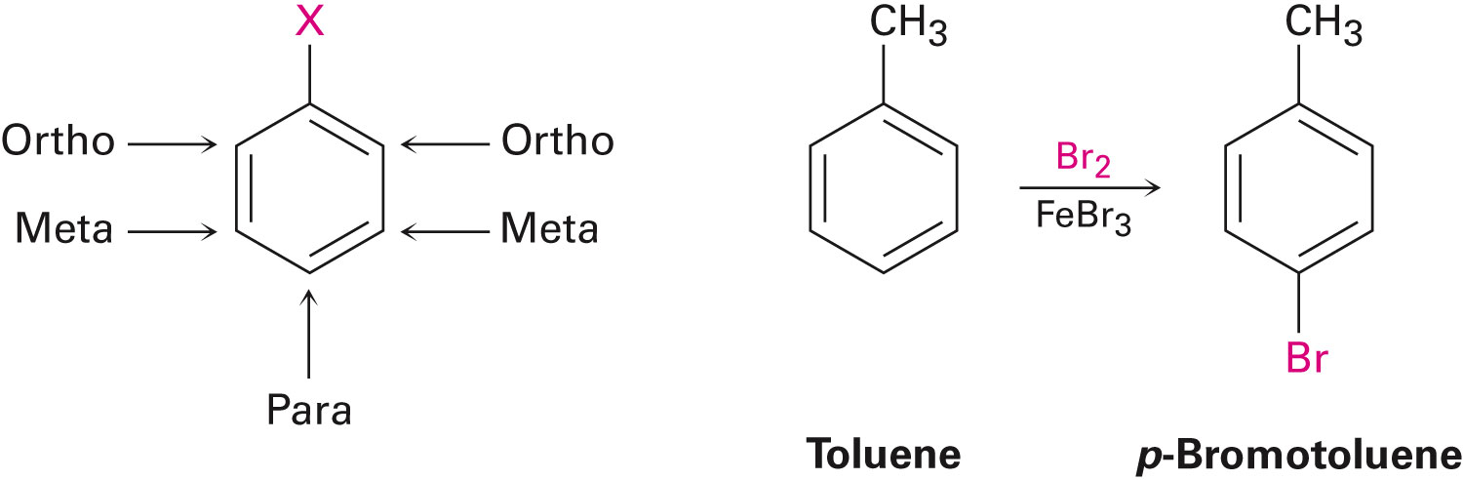
Disubstituted Benzenes
Names based on the placement of substituents
Ortho (o), meta (m) , and para (p)
Provides clarity in the discussion of reactions
Notes:
Naming aromatic compounds

Slide 10
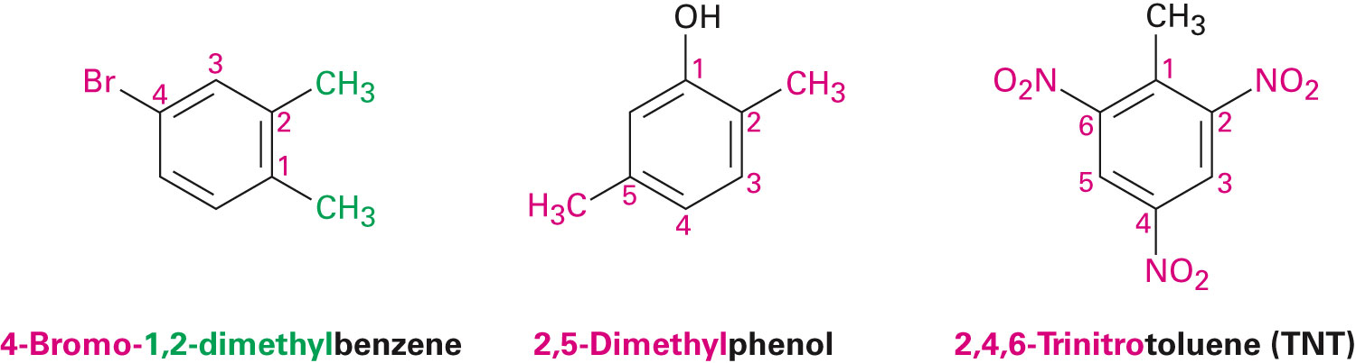
Benzenes With More Than Two Substituents
Numbers with the lowest possible values are chosen
List substituents alphabetically with hyphenated numbers
Common names, such as toluene can serve as root name(as in TNT)
Notes:
Naming aromatic compounds

Slide 11
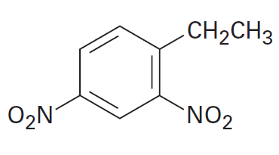
Worked Example
Provide the IUPAC name for the following compound
Solution:
The compound is 1-Ethyl-2,4-dinitrobenzene
Substituents on trisubstituted rings receive the lowest possible numbers
Notes:
Naming aromatic compounds

Slide 12
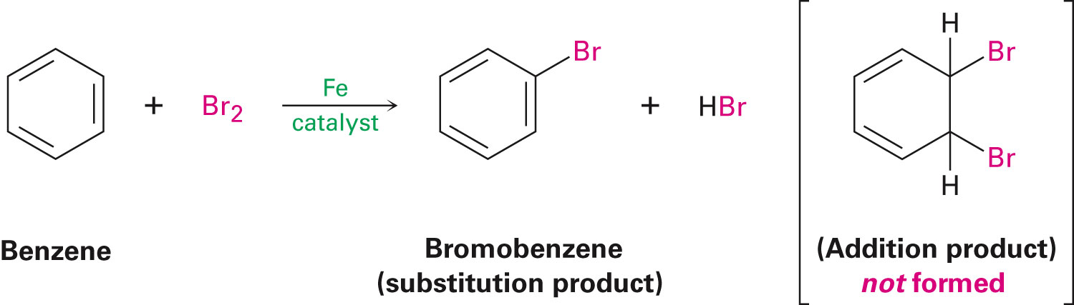
Structure and Stability of Benzene
The reactivity of benzene is much lesser than that of alkenes despite having six fewer hydrogens
Benzene - C₆H₆
Cycloalkane - C₆H₁₂
Notes:
Structure and stability of benzene

Slide 13
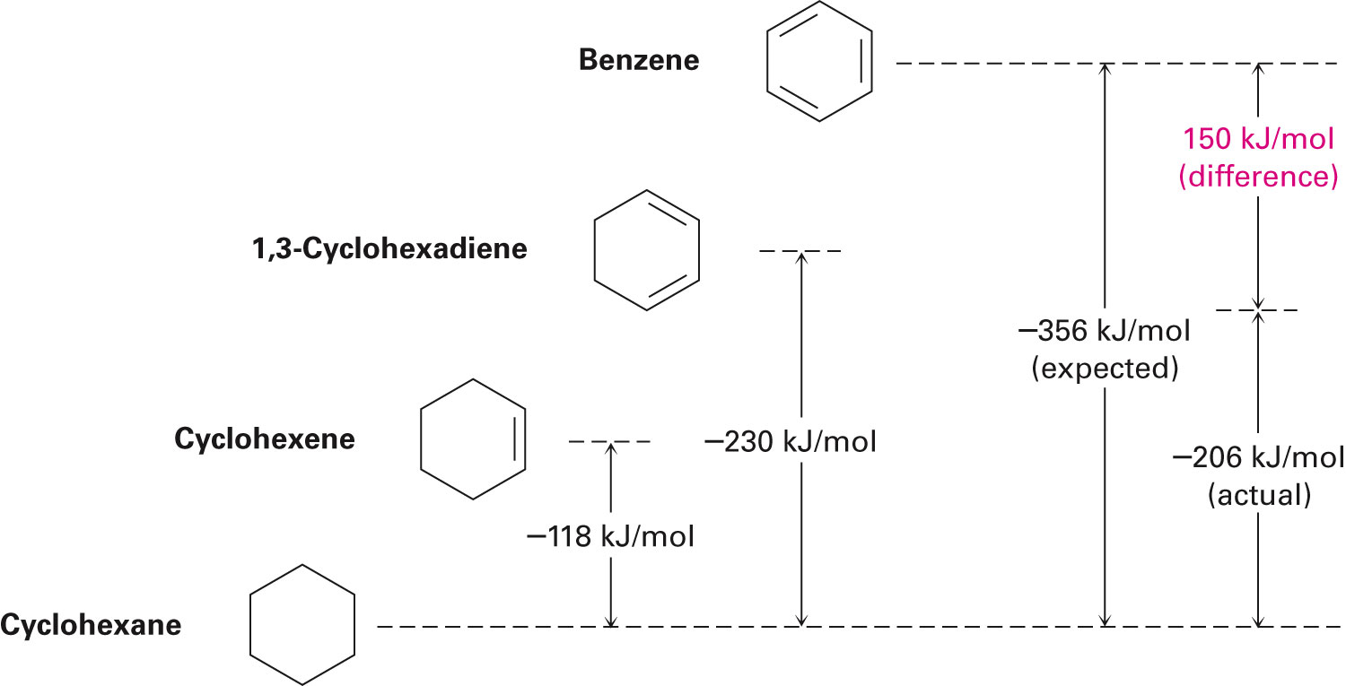
Heats of Hydrogenation as Indicators of Stability
Comparison of the heats of hydrogenation proves the stability of benzene
Notes:
Structure and stability of benzene

Slide 14
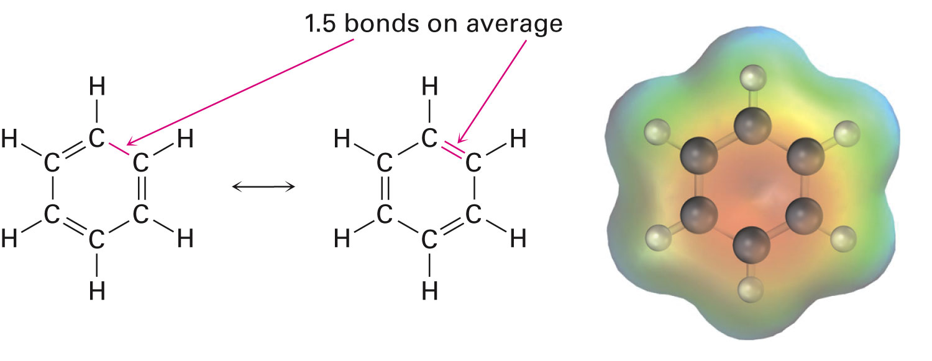
Structure of Benzene
All its C-C bonds are the same length: 139 pm — between single (154 pm) and double (134 pm) bonds
Electron density in all six C-C bonds is identical
Structure is planar, hexagonal
Notes:
Structure and stability of benzene

Slide 15
Structure of Benzene
Carbon atoms and p orbitals in benzene are equivalent
Defining three localized π bonds in which a given p orbital overlaps only one neighboring p orbital
All π electrons move freely in the entire ring due to equal overlap of all p orbitals
Resonance of benzene is another factor that influences its rate of reactivity
Notes:
Structure and stability of benzene

Slide 16
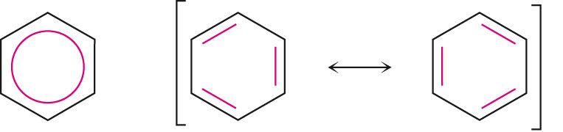
Indicating Carbon–Carbon Bond Equivalence in Benzenes
The two benzene resonance forms can be represented by a single structure with a circle in the center to indicate the equivalence of the carbon–carbon bonds
The ring does not indicate the number of π electrons in the ring but is a reminder of the delocalized structure
Notes:
Structure and stability of benzene

Slide 17
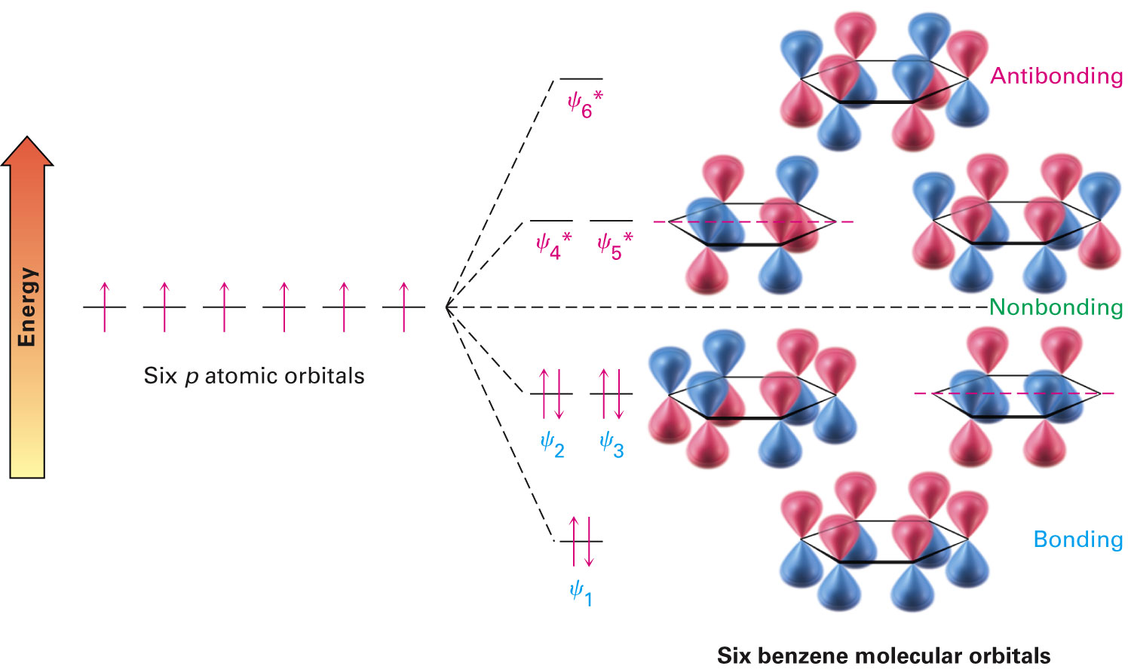
Molecular Orbital Description of Benzene
The 6 p-orbitals combine to give:
Three bonding orbitals with 6 π electrons
Three antibonding with no electrons
Orbitals with the same energy are degenerate
Notes:
Structure and stability of benzene

Slide 18
Worked Example
Pyridine - A flat, hexagonal molecule with bond angles of 120°undergoes substitution rather than addition and generally behaves like benzene
Draw a picture of the π orbitals of pyridine to explain its properties
Notes:
Structure and stability of benzene

Slide 19
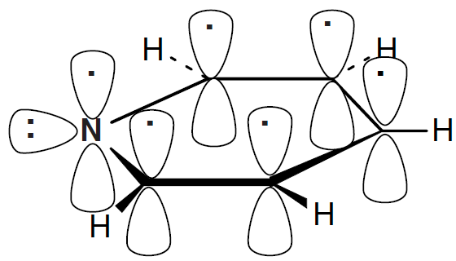
Worked Example
Solution:
The pyridine ring is formed by the σ overlap of carbon and nitrogen sp² orbitals
Six p orbitals perpendicular to the plane of the ring hold six electrons
Notes:
Structure and stability of benzene

Slide 20
Worked Example
These six p orbitals form six π molecular orbitals that allow electrons to be delocalized over the π system of the pyridine
The lone pair of nitrogen occupies an sp² orbital that lies in the plane of the ring
Notes:
Structure and stability of benzene

Slide 21
Aromaticity and the Hückel 4n+2 Rule
Unusually stable - Heat of hydrogenation 150 kJ/mol less negative than a hypothetical cyclic triene
Planar hexagon - Bond angles are 120°, carbon-carbon bond length is 139 pm
Undergoes substitution rather than electrophilic addition
Resonance hybrid with structure between two line-bond structures
Notes:
Aromaticity and the Hückel 4n + 2 rule

Slide 22
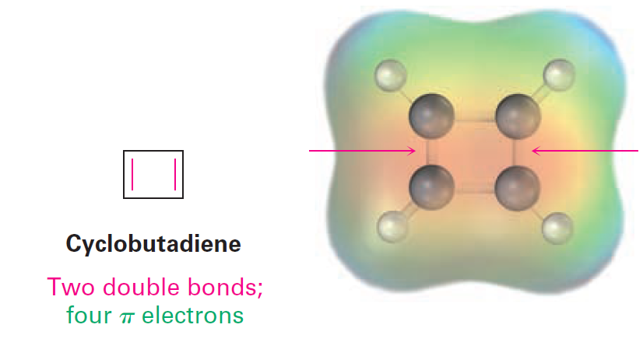
The Hückel 4n + 2 Rule
Developed by Erich Hückel in 1931
States that a molecule can be aromatic only if:
It has a planar, monocyclic system of conjugation
It contains a total of 4n + 2π molecules
n = 0,1,2,3…
4n π electrons are considered antiaromatic
Cyclobutadiene possesses four electrons and is antiaromatic
Notes:
Aromaticity and the Hückel 4n + 2 rule

Slide 23

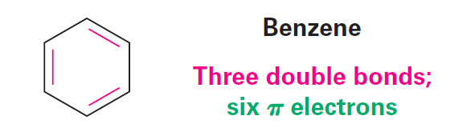
The Hückel 4n + 2 Rule
It reacts readily and exhibits none of the properties corresponding to aromaticity
It dimerizes by a Diels-Alder reaction at –78 °C
Benzene possesses six π electrons (4n + 2 = 6 when n = 1) and is aromatic
Notes:
Aromaticity and the Hückel 4n + 2 rule

Slide 24
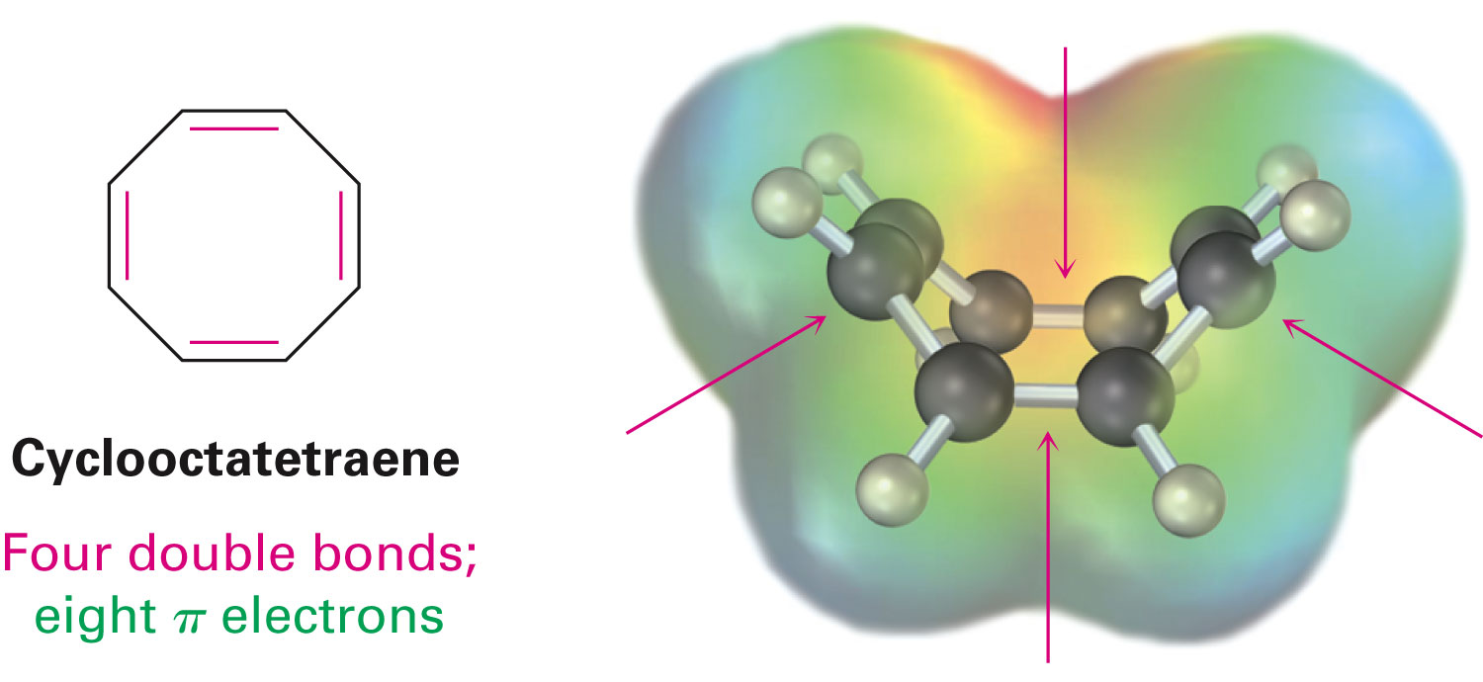
The Hückel 4n + 2 Rule
Cyclooctatetraene possesses eight π molecules and is not aromatic
Comprises four double bonds
Notes:
Aromaticity and the Hückel 4n + 2 rule

Slide 25
Aromatic Stability and the Molecular Orbital Theory
Calculation of energy levels of molecular orbitals for cyclic conjugated molecules shows that there is always a single lowest-lying MO above which MOs come in degenerate pairs
Lowest lying molecular orbital is filled by a pair of electrons and higher orbitals are filled by two pairs of electrons
Notes:
Aromaticity and the Hückel 4n + 2 rule

Slide 26
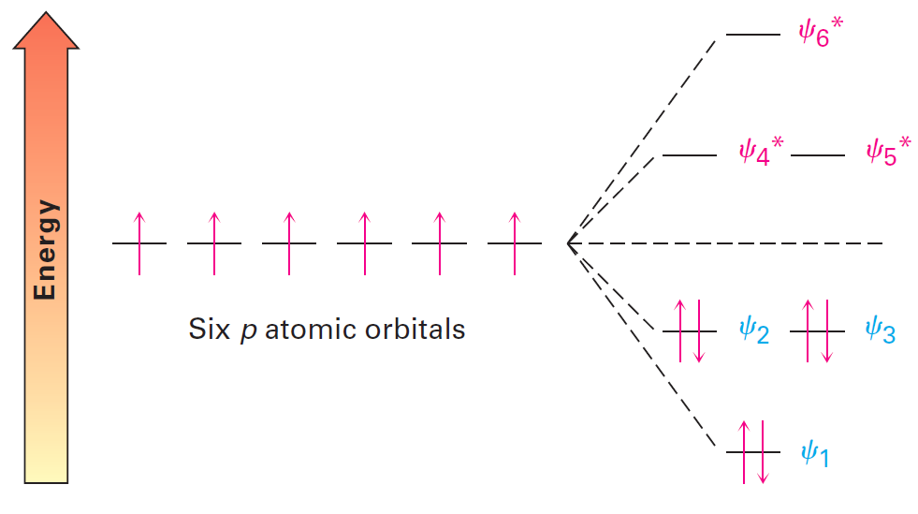
Figure 15.5 - Energy Levels of the Six Benzene π Molecular Orbitals
Notes:
Aromaticity and the Hückel 4n + 2 rule

Slide 27
Worked Example
To be aromatic, a molecule must have 4n + 2 π electrons and must have a planar, monocyclic system of conjugation
Explain why cyclodecapentaene has resisted all attempts at synthesis though it has fulfilled only one of the above criteria
Notes:
Aromaticity and the Hückel 4n + 2 rule

Slide 28
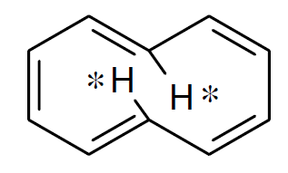
Worked Example
Solution:
Cyclodecapentaene possesses 4n + 2 π (n = 2) but is not flat
If cyclodecapentaene were flat, the starred hydrogen atoms would crowd each other across the ring
To avoid this interaction, the ring system is distorted from planarity
Notes:
Aromaticity and the Hückel 4n + 2 rule

Slide 29
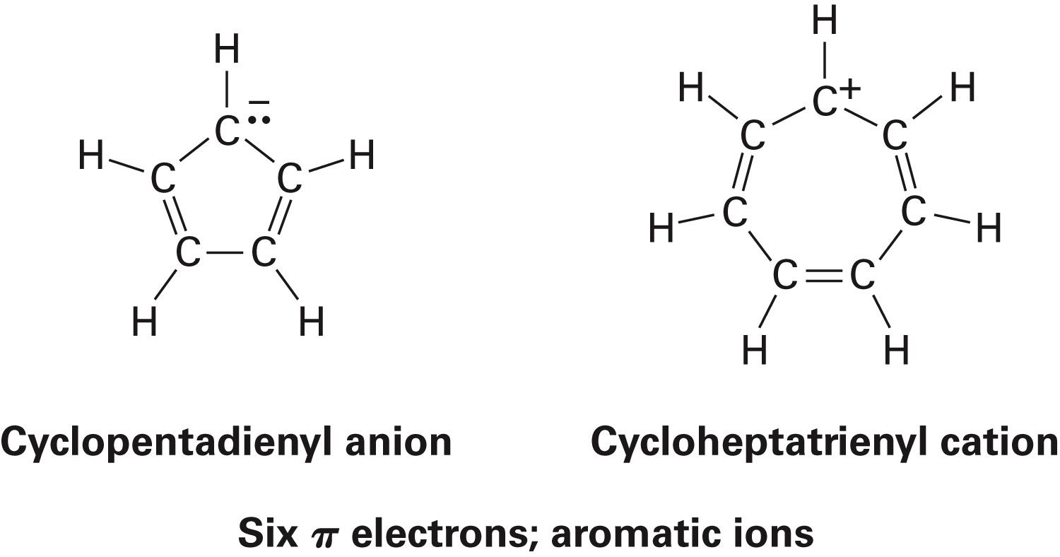
Aromatic Ions
The 4n + 2 rule applies to ions as well as neutral substances
Both the cyclopentadienyl anion and the cycloheptatrienyl cation are aromatic
Notes:
Aromatic ions

Slide 30
Aromatic Ions
When one hydrogen is removed from the saturated CH₂ in an aromatic ion, rehybridization of the carbon from sp³ to sp² would result in a fully conjugated product with a p orbital on every product
Methods to remove the hydrogen molecule
Removing the hydrogen with both electrons (H:–) from the C–H bond results in a carbocation
Removing the hydrogen with one electron (H·) from the C–H bond results in a carbon radical
Removing the hydrogen without any electrons (H⁺) from the C–H bond results in a carbanion
Notes:
Aromatic ions

Slide 31
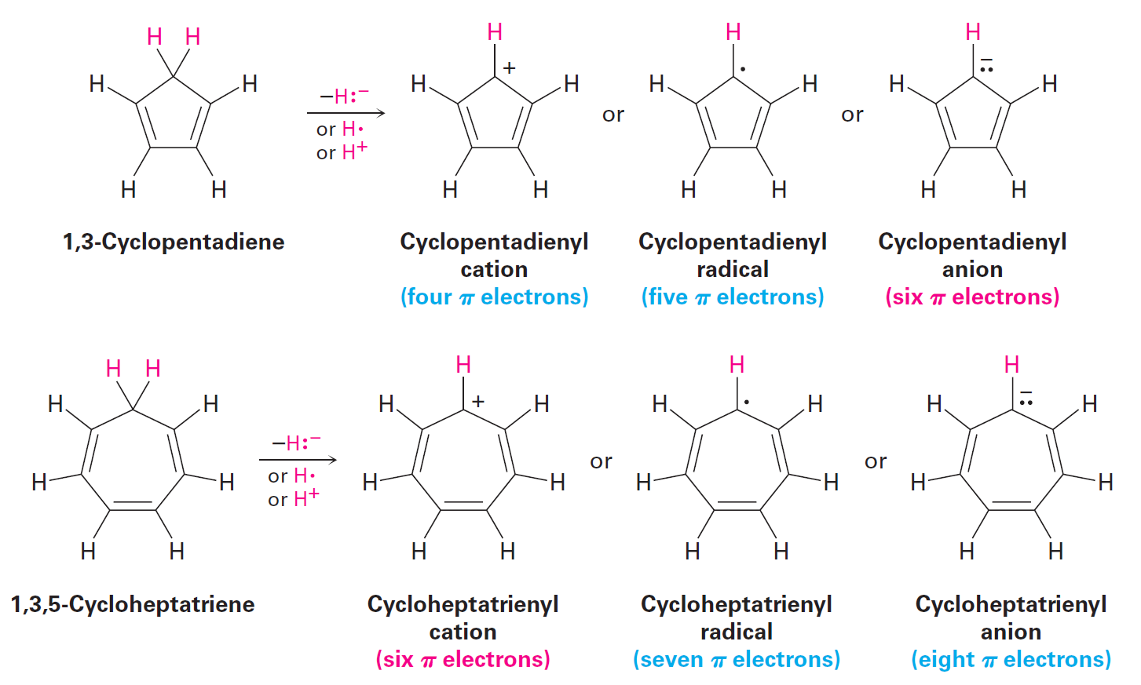
Figure 15.6 - Cyclopentadienyl Anion and Cycloheptatrienyl Cation
Notes:
Aromatic ions

Slide 32
Aromaticity of Cyclopentadienyl Anion
Disadvantages of the four-π-electron cyclopentadienyl cation and the five-π-cyclopentadienyl radical
Highly reactive
Difficult to prepare
Not stable enough for aromatic systems
Advantages of using the six-π-electron cyclopentadienyl cation
Easily prepared
Extremely stable
pK_{a} =16
Notes:
Aromatic ions

Slide 33
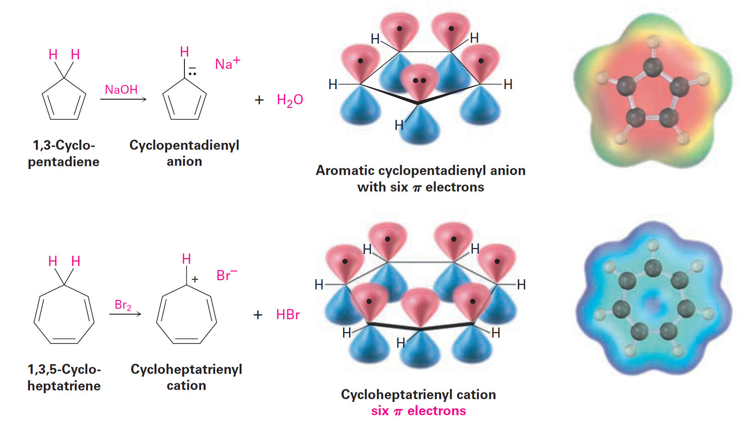
Figure 15.7 - The Aromatic Cyclopentadienyl Anion and the Aromatic Cycloheptatrienyl Cation
Notes:
Aromatic ions

Slide 34
Worked Example
Cyclooctatetraene readily reacts with potassium metal to form the stable cyclooctatetraene dianion, C₈H₈^{2–}
Explain why this reaction occurs so easily
Determine the geometry for the cyclooctatetraene dianion
Notes:
Aromatic ions

Slide 35
Worked Example
Solution:
When cyclooctatetrene accepts two electrons, it becomes a (4n + 2) π electron aromatic ion
Cyclooctatetraenyl dianion is planar with a carbon–carbon bond angle of 135°, that of a regular octagon
Notes:
Aromatic ions

Slide 36
Aromatic Heterocycles: Pyridine and Pyrrole
Heterocycle: Cyclic compound that comprises atoms of two or more elements in its ring
Carbon along with nitrogen, oxygen, or sulfur
Aromatic compounds can have elements other than carbon in the ring
Notes:
Aromatic heterocycles: Pyridine and pyrrole

Slide 37
Pyridine
Six-membered heterocycle with a nitrogen atom in its ring
π electron structure resembles benzene (6 electrons)
The nitrogen lone pair electrons are not part of the aromatic system (perpendicular orbital)
Pyridine is a relatively weak base compared to normal amines but protonation does not affect aromaticity
Notes:
Aromatic heterocycles: Pyridine and pyrrole

Slide 38
Pyridine and Pyrimidine
The π structure of pyridine is quite similar to that of benzene
All five sp²-hybridized ions possess a p orbital perpendicular with one to the plane of the ring
Each p orbital comprises one π electron
The nitrogen atom is also sp²-hybridized and possesses one electron in a p orbital
Pyrimidine comprises two nitrogen atoms in a six-membered, unsaturated ring
The sp²-hybridized nitrogen atoms share an electron each to the aromatic π system
Notes:
Aromatic heterocycles: Pyridine and pyrrole

Slide 39
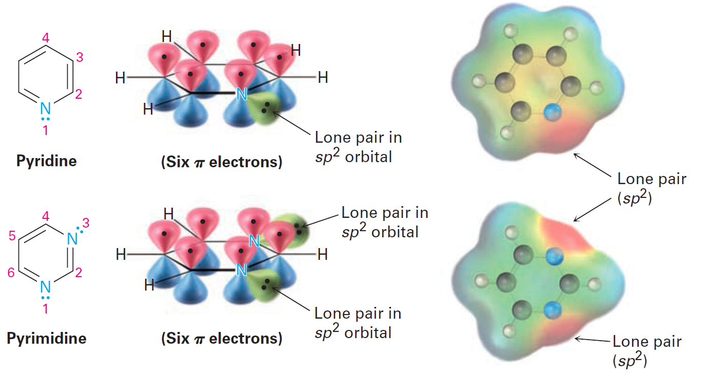
Figure 15.8 - Pyridine and Pyrimidine
Notes:
Aromatic heterocycles: Pyridine and pyrrole

Slide 40
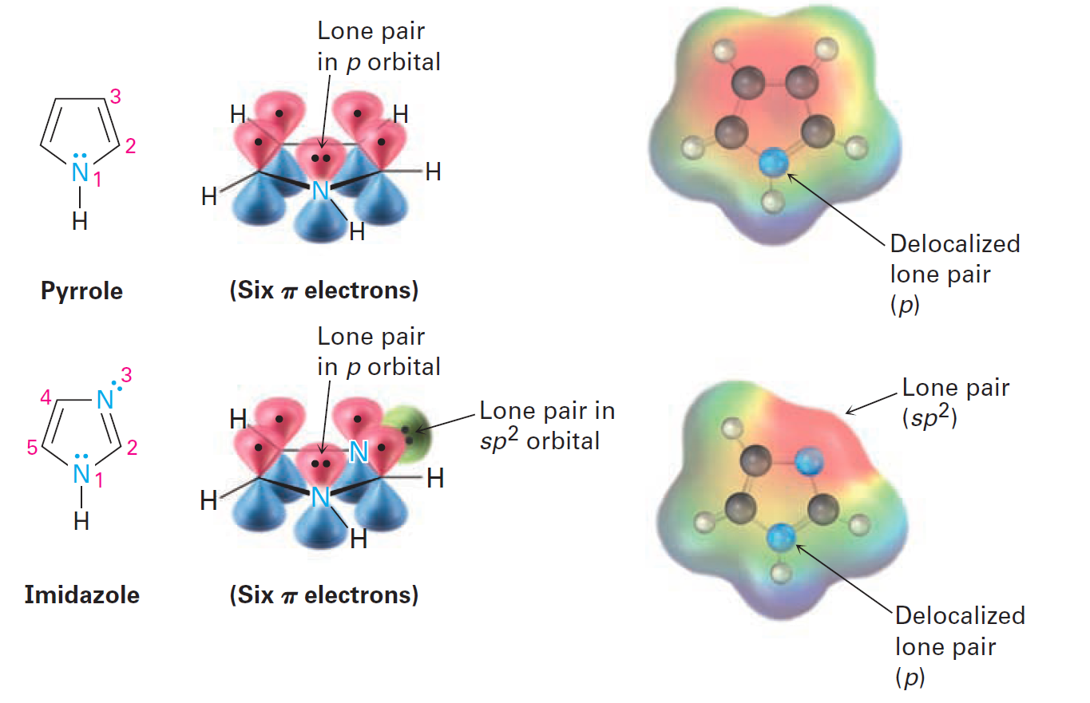
Figure 15.9 - Pyrrole and Imidazole
Notes:
Aromatic heterocycles: Pyridine and pyrrole

Slide 41
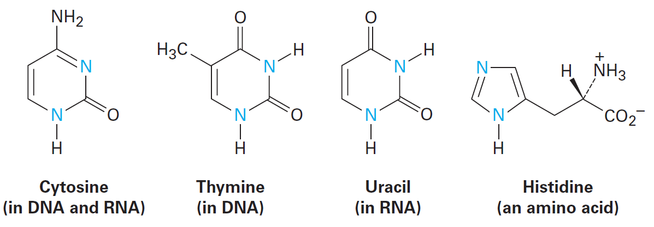
Rings of Pyrimidine and Imidazole
Significant in biological chemistry
Pyrimidine is the parent ring system present in cytosine, thymine, and uracil
Histidine contains an aromatic imidazole ring
Notes:
Aromatic heterocycles: Pyridine and pyrrole

Slide 42
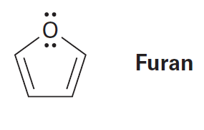
Worked Example
Draw an orbital picture of Furan to show how the molecule is aromatic
Notes:
Aromatic heterocycles: Pyridine and pyrrole

Slide 43
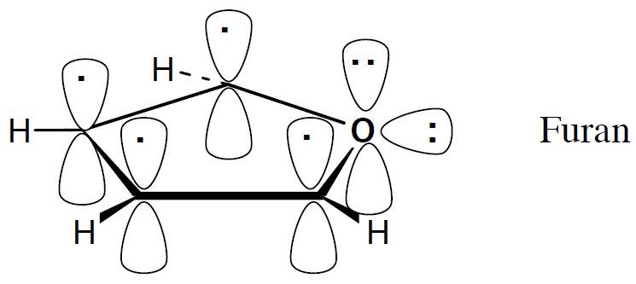
Worked Example
Solution:
Furan is an oxygen analog of pyrrole
It possesses 6 π electrons on a cyclic, conjugated system; it is aromatic
Oxygen contributes two lone-pair electron from a p orbital perpendicular to the plane of the ring
Notes:
Aromatic heterocycles: Pyridine and pyrrole

Slide 44
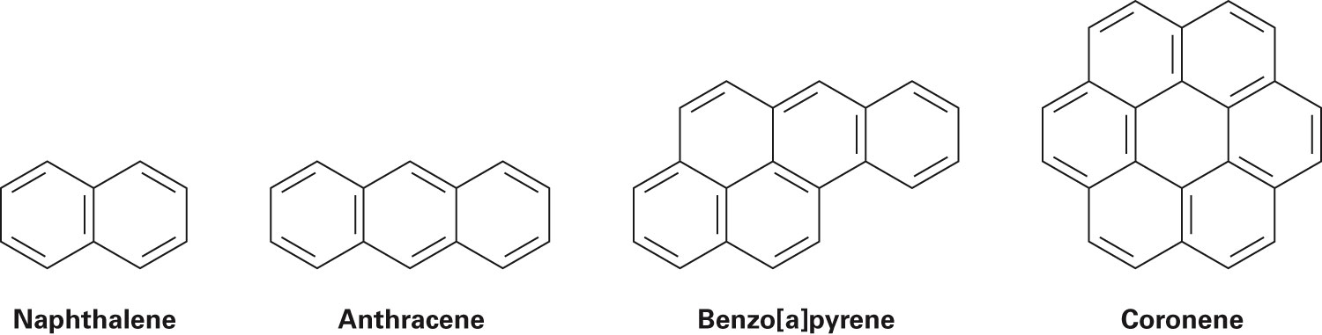
Polycyclic Aromatic Compounds
While the Hückel rule is relevant only to monocyclic compounds, the concept of aromaticity can also be applied to polycyclic aromatic compounds
Notes:
Polycyclic aromatic compounds

Slide 45
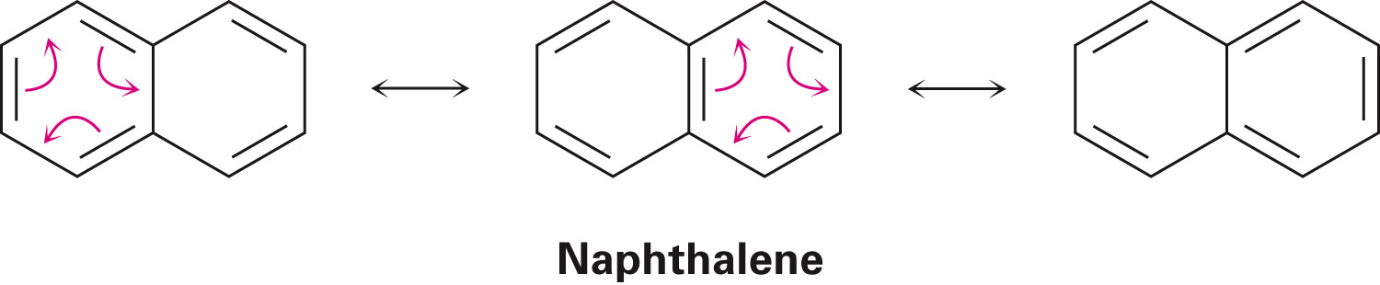
Naphthalene Orbitals
Three resonance forms and delocalized electrons
Naphthalene and other polycyclic aromatic hydrocarbons possess certain chemical properties that correspond to aromaticity
Heat of hydrogenation in naphthalene is approximately 250 kJ/mol
Notes:
Polycyclic aromatic compounds

Slide 46
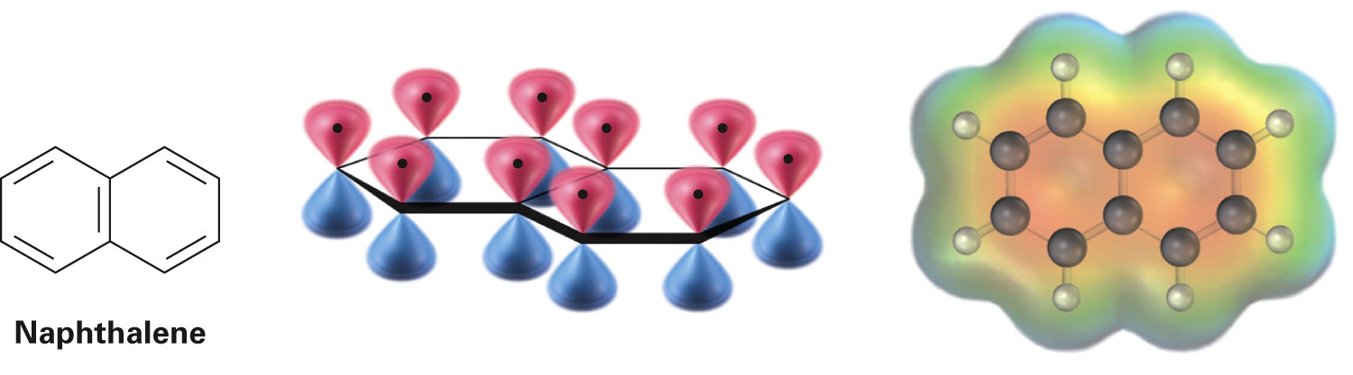
Aromaticity of Naphthalene
Naphthalene possesses a cyclic, conjugated electron system
p orbital overlap is present along the ten-carbon periphery of the molecule and across the central bond
Aromaticity is due to the π electron delocalization caused by the presence of ten π electrons (Hückel number)
Notes:
Polycyclic aromatic compounds

Slide 47
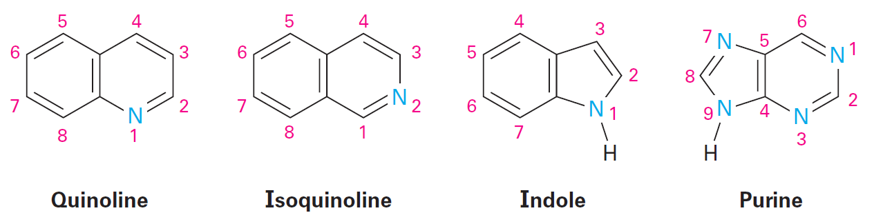
Heterocyclic Analogs of Naphthelene
Quinolone, isoquinolone, and purine have pyridine-like nitrogens that share one π electron
Indole and purine have pyrrole-like nitrogens that share two π electrons
Notes:
Polycyclic aromatic compounds

Slide 48
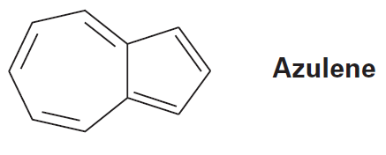
Worked Example
Azulene, a beautiful blue hydrocarbon, is an isomer of naphthalene
Determine whether it is an aromatic
Draw a second resonance form of azulene in addition to the form shown below
Notes:
Polycyclic aromatic compounds

Slide 49
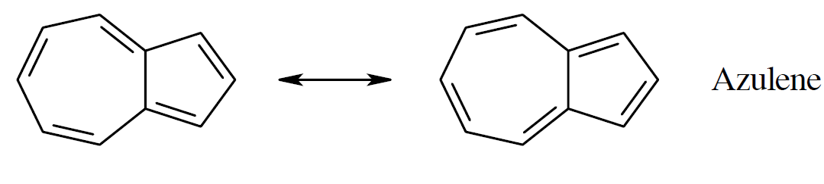
Worked Example
Solution:
Azulene is an aromatic because it has a conjugated cyclic π electron system containing ten π electrons (a Hückel number)
Notes:
Polycyclic aromatic compounds

Slide 50
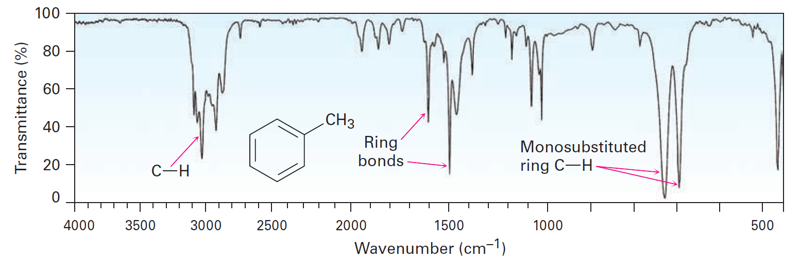
Spectroscopy of Aromatic Compounds
Infrared Spectroscopy
C–H stretching absorption is seen at 3030 cm^{–1}
Usually of low intensity
A series of peaks are present between 1450 and 1600 cm^{–1}
Caused by the complex molecular motions of the ring
Notes:
Spectroscopy of aromatic compounds

Slide 51
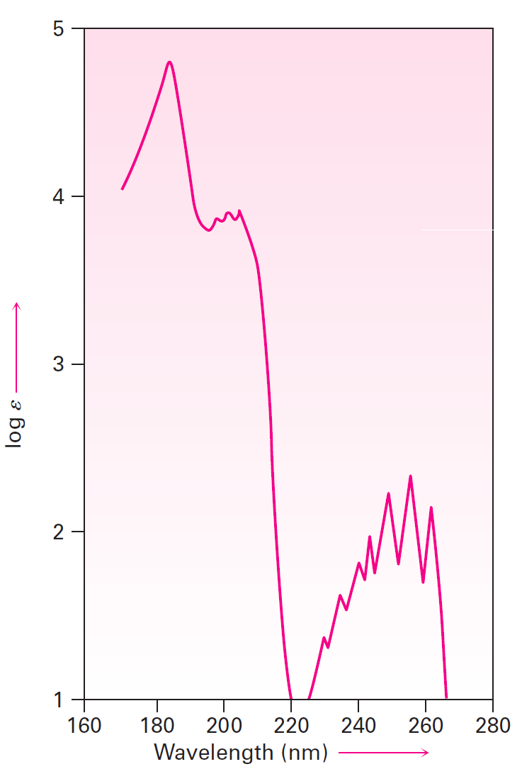
Ultraviolet Spectroscopy
Presence of a conjugated π system makes ultraviolet spectroscopy possible
Intense absorption occurs near 205 nm
Less intense absorption occurs between 255 nm and 275 nm
Notes:
Spectroscopy of aromatic compounds

Slide 52
Nuclear Magnetic Resonance Spectroscopy
The aromatic ring shields hydrogens
Absorption occurs between 6.5 and 8.5 δ
The ring current is responsible for the difference in chemical shift between aromatic and vinylic protons
Ring current is the magnetic field caused by the circulation of delocalized π electrons when the aromatic ring is perpendicular to a strong magnetic field
The effective magnetic field is greater than the applied field
Notes:
Spectroscopy of aromatic compounds

Slide 53
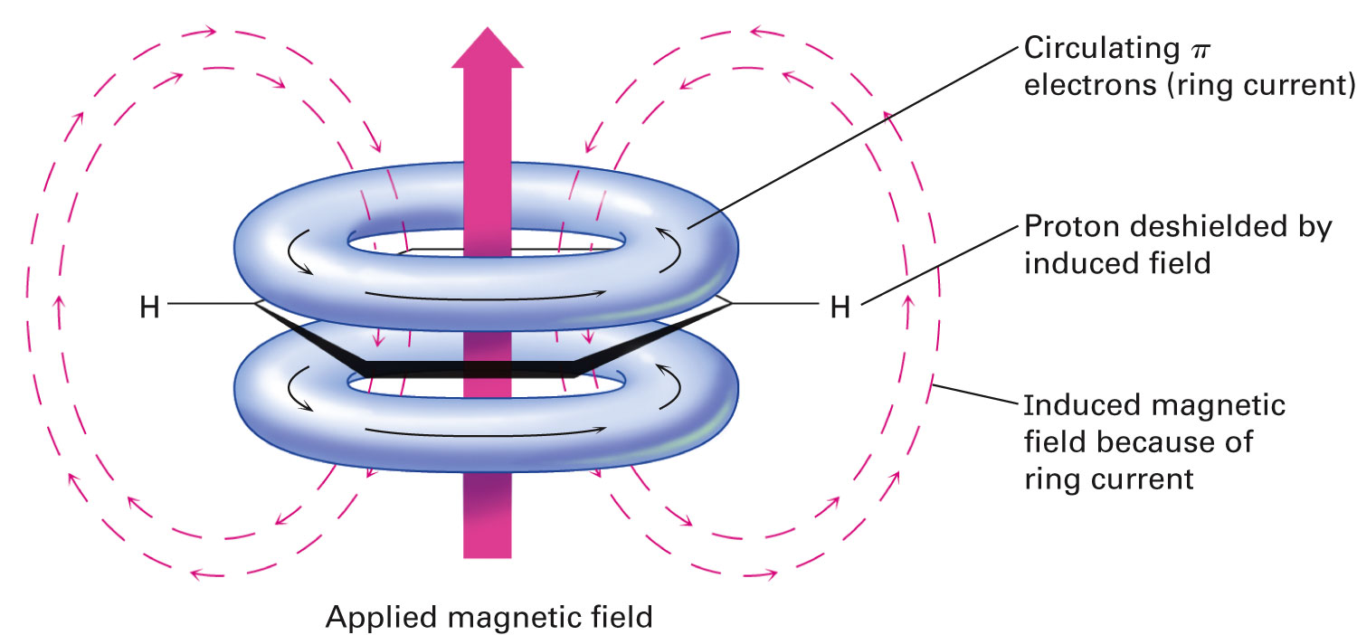
Figure 15.13 - The Origin of Aromatic Ring Current
Notes:
Spectroscopy of aromatic compounds

Slide 54
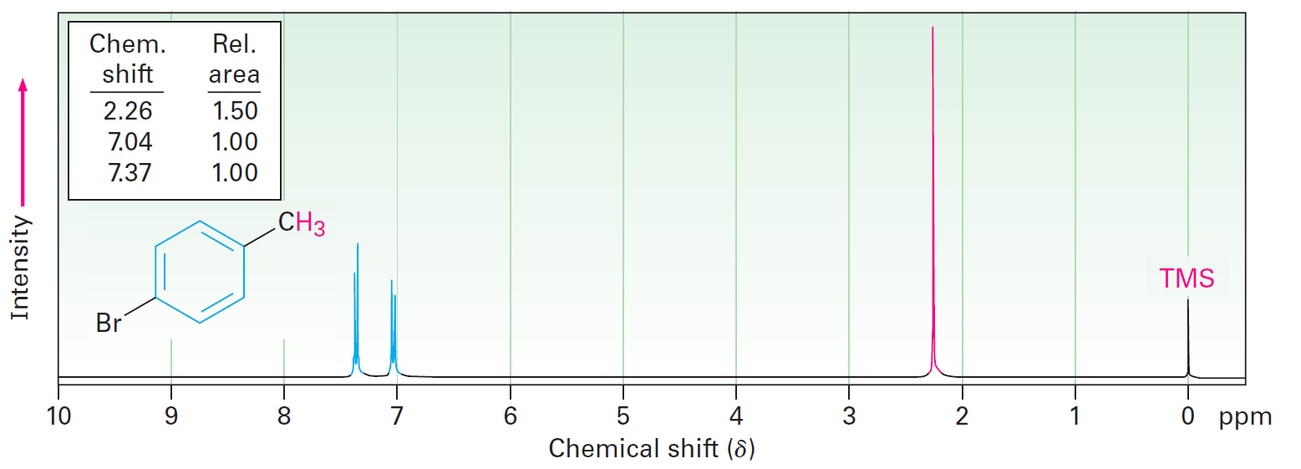
Nuclear Magnetic Resonance Spectroscopy
Aromatic protons appear as two doublets at 7.04 and 7.37 δ
Benzylic methyl protons appear as a sharp singlet at 2.26 δ
Notes:
Spectroscopy of aromatic compounds

Slide 55
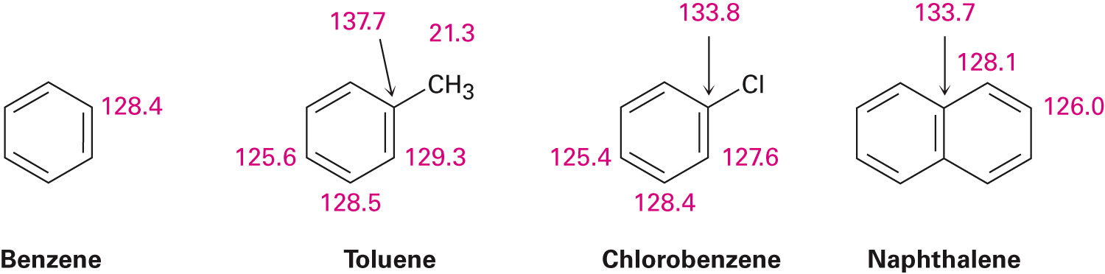
¹³C NMR of Aromatic Compounds
Carbons in aromatic ring absorb between 110 and 140 δ
Shift is distinct from alkane carbons but in same range as alkene carbons
Notes:
Spectroscopy of aromatic compounds

Slide 56
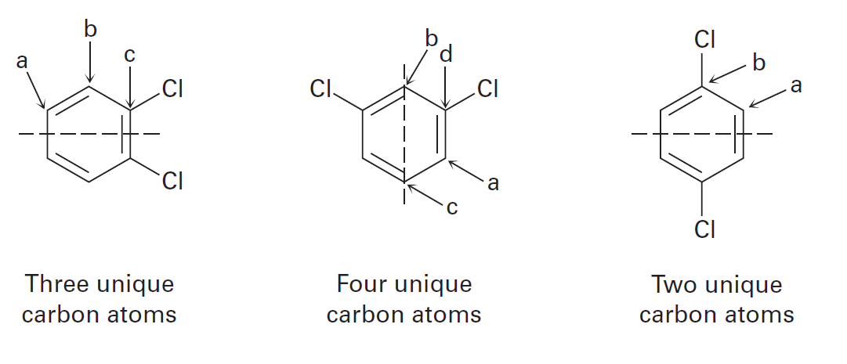
¹³C NMR of Aromatic Compounds
The mode of substitution influences the formation of two, three, or four resonances in the proton-decoupled ¹³C NMR spectrum
Notes:
Spectroscopy of aromatic compounds

Slide 57
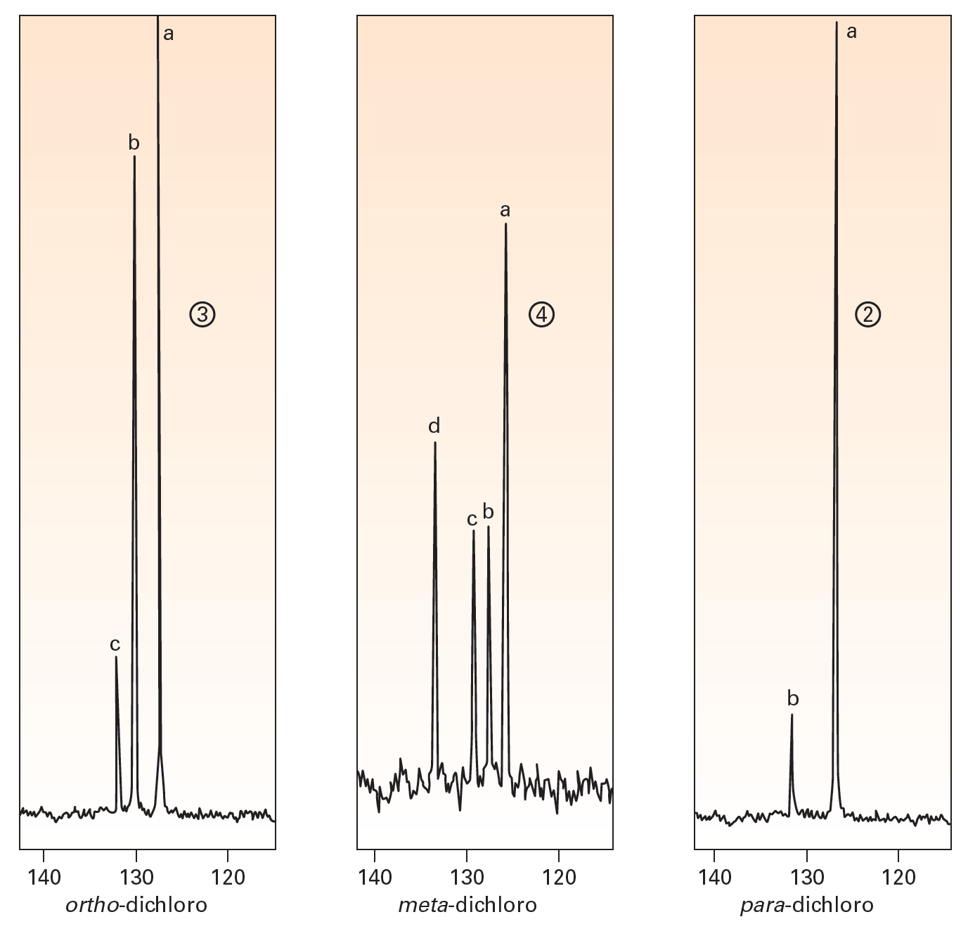
Figure 15.16 - The Proton-Decoupled ¹³C NMR Spectra of the Three Isomers of Dichlorobenzene
Notes:
Spectroscopy of aromatic compounds

Slide 58
Summary
The term aromatic refers to the class of compounds that are structurally similar to benzene
Apart from IUPAC terms, disubstituted benzenes are also called ortho, meta, or para derivatives
The C₆H₅ unit is called a phenyl group
The C₆H₅CH₂ unit is called a benzyl group
The Hückel rule states that in order to be aromatic, a molecule must possess 4n + 2 π electrons, where InI = 0,1,2,3, and so on

Slide 59
Summary
Planar, cyclic, conjugated molecules with other numbers of π electrons are antiaromatic
Pyridine and pyrimidine are six-membered, nitrogen containing, aromatic heterocycles

